Slide 1






Climate Risk & Child Poverty in Nigeria
UCT, August 2023
Hernando Grueso William Rudgard
In collaboration with Enrique Delamónica, Oliver Fiala, Lucie Cluver, Seth Flaxman, Elizabeta Semenova, Selam Petros, Boladé Banougnin, and Bothaina Eltigani

Slide 2
Motivation
There is a lack of understanding of the association between extreme weather events and child poverty
Even though there is an increasing interest on studying how climate change affects vulnerable children, nobody seems to know how climate change affects child poverty
Some early assessment indicate the climate is actually not related to poverty (e.g., climate change affects everyone equally)
Floods represent a particular type of extreme weather event, and Nigeria is a country that experiences high levels of both flooding and poverty

Slide 3
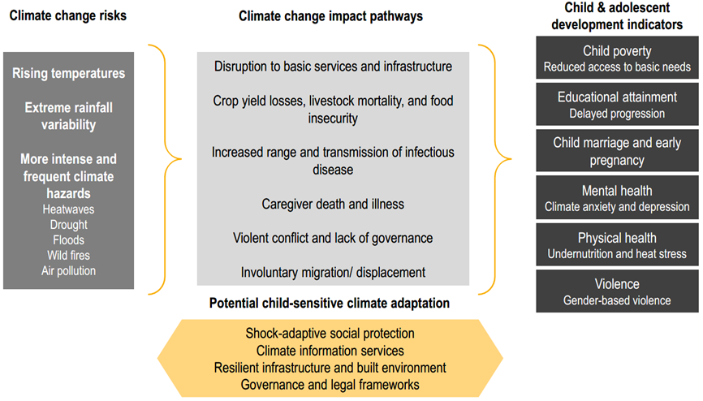
Literature Review

Slide 4
Methods
RQ: To what extent is there an association between multidimensional child poverty and flooding in Nigeria?
Data:
DHS: Household surveys
The Global Flood Database/NASA: Satellite images
Cross-Section: Nigeria, 2018
Sample:
35,672 Children (Age: 0-17)
13.4 million GPS coordinates of flooding
Empirical Strategy:
Kernel Density Estimation (KDE): A ML technique to identify flooded areas based on density of GPS coordinates indicating flooding
Logistic regression to study the relationship between proximity to flooding areas and poverty
Outcome Variable: Multidimensional Child Poverty according to UNICEF definition

Slide 5
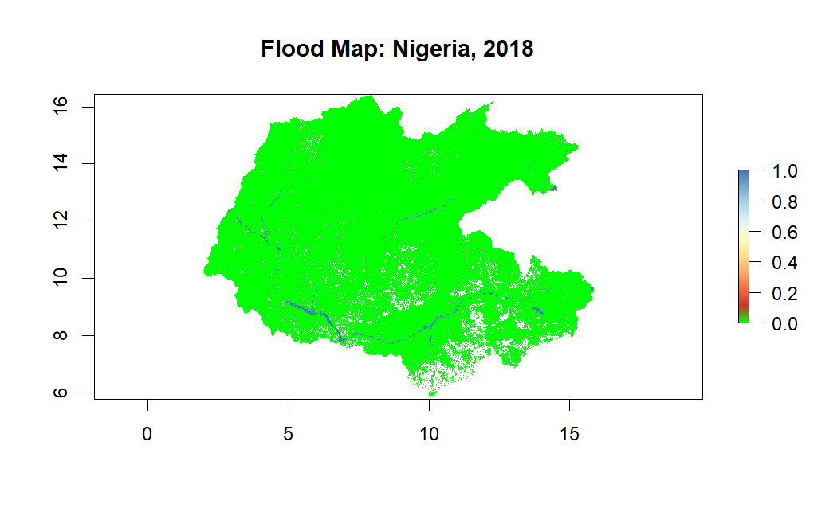
Data Source: Global Flood Database (2018)

Slide 6
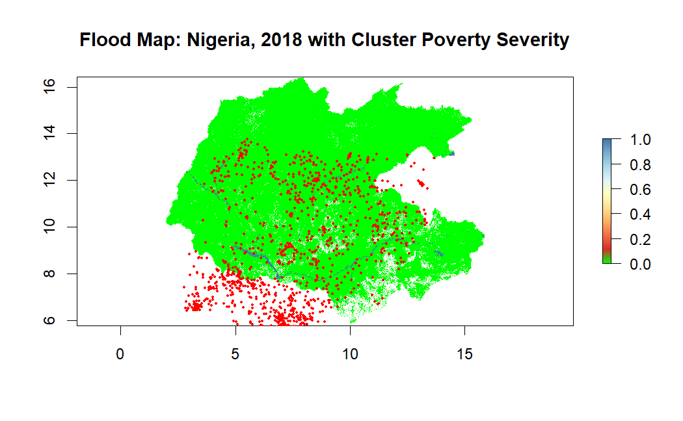
Data Source: Global Flood Database + DHS (2018)

Slide 7
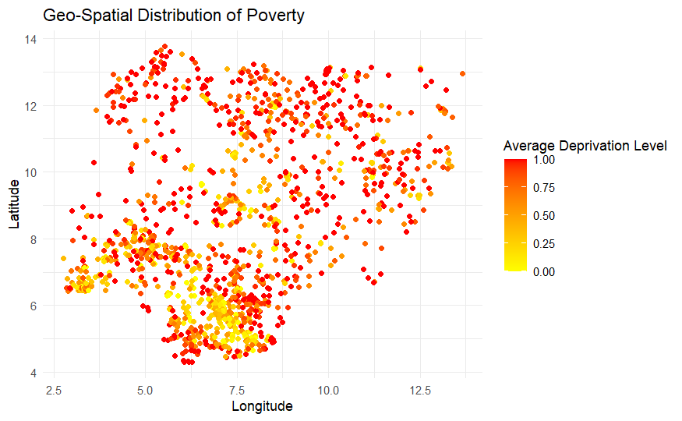
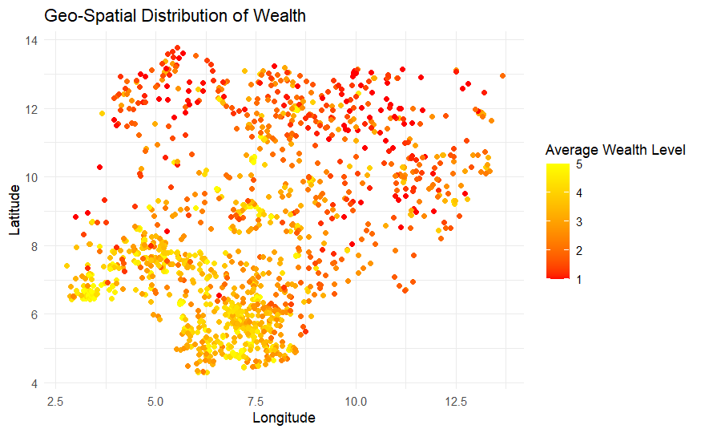
Data Source: DHS (2018)

Slide 8
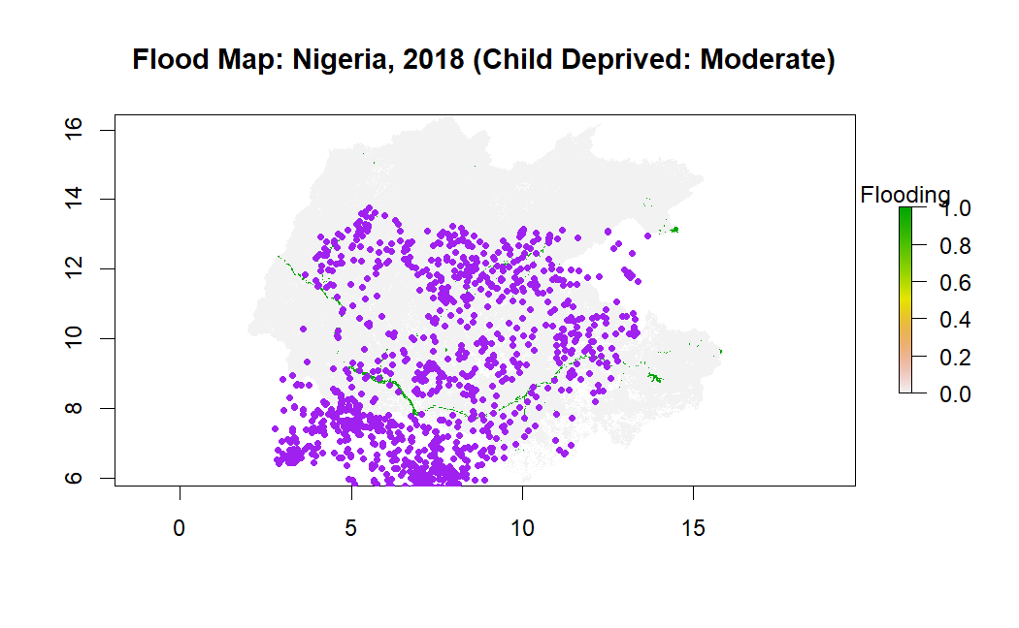
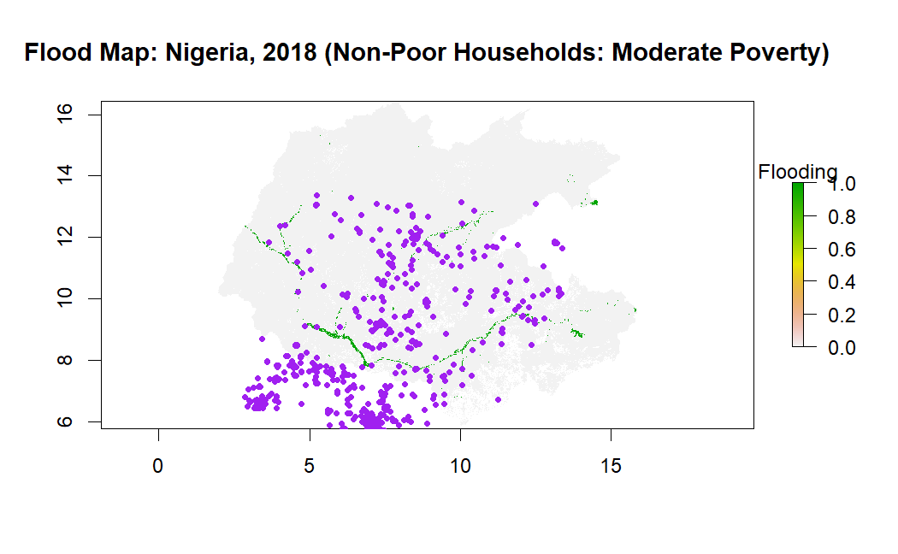
Flood Map + DHS Poor Households
Data Source: Global Flood Database + DHS (2018)

Slide 9
Descriptive Statistics:

Slide 10
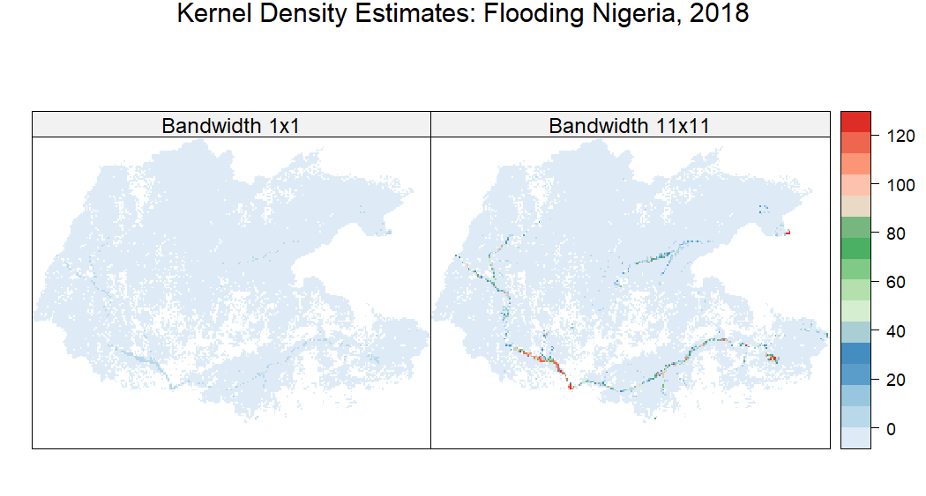

Slide 11
Descriptive Statistics: KDE 11X11 (N=754)

Slide 12
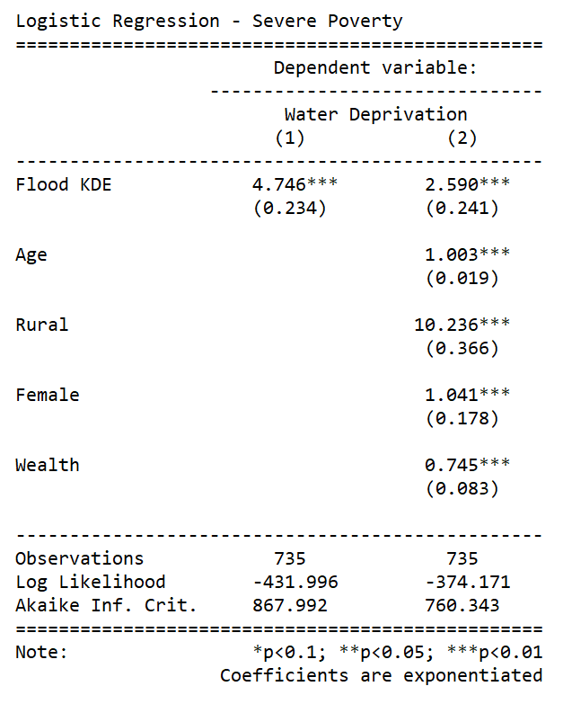
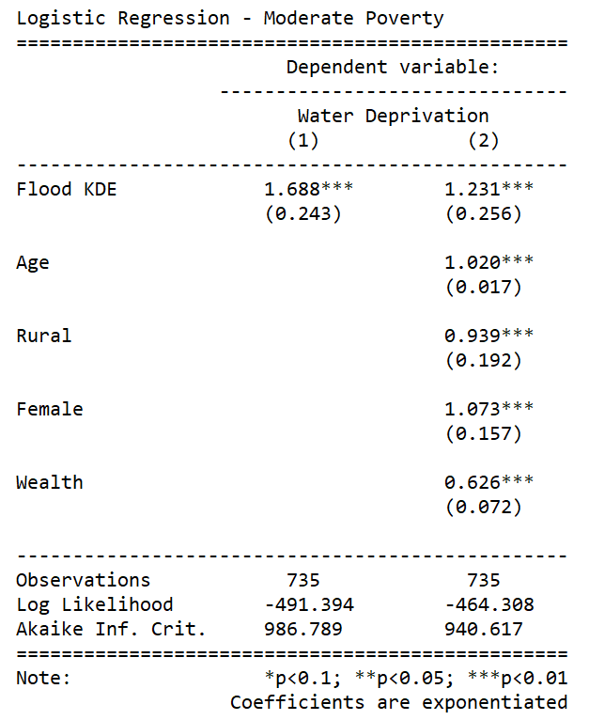
Regression Results

Slide 13


Regression Results

Slide 14
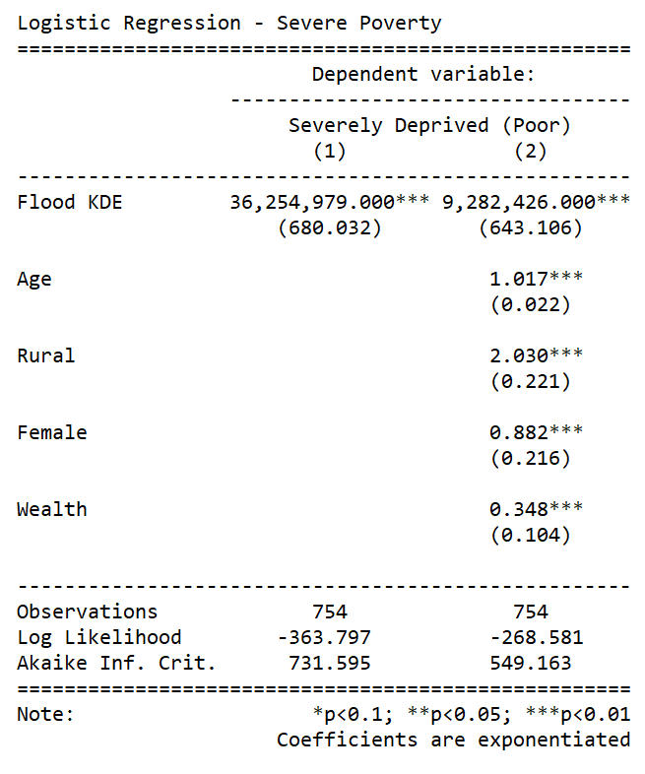
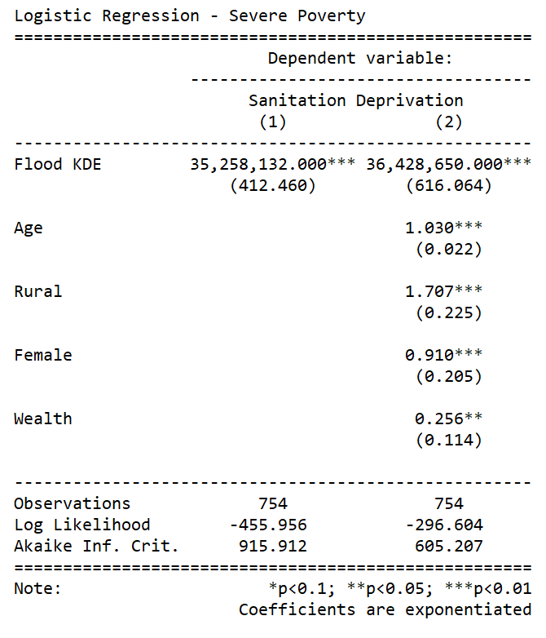
Regression Results

Slide 15
Conclusion & Next Steps
Children living in areas affected by flooded are more likely to be multidimensionally deprived (poor)
Lack of access to sanitation seems to be driving child poverty in flooded areas of Nigeria
Children living in areas affected by flooding have lower levels of access to water and education, compared to neighbouring children
Even though flooding is not the main cause of child poverty in Nigeria, poor children seem disproportionality affected by it
Further research is required to understand how to adapt social protection programs to safeguard children against climate-related risks, such as flooding

Slide 16
Thank you! hernando.gruesohurtado@spi.ox.ac.uk william.rudgard@spi.ox.ac.uk

Slide 17
Annex

Slide 18


Regression Results

Slide 19


Regression Results

Slide 20

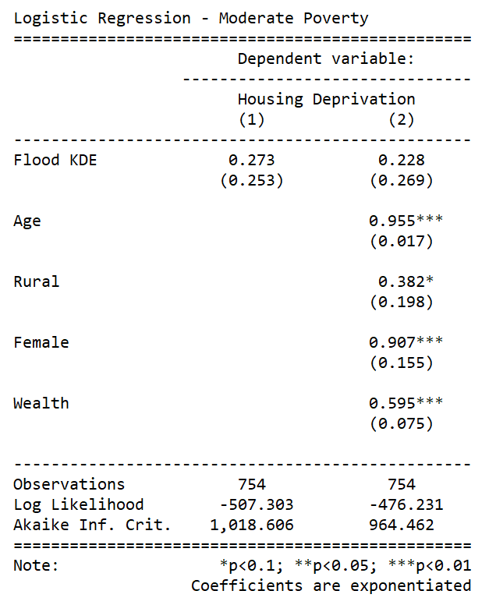
Regression Results

Slide 21
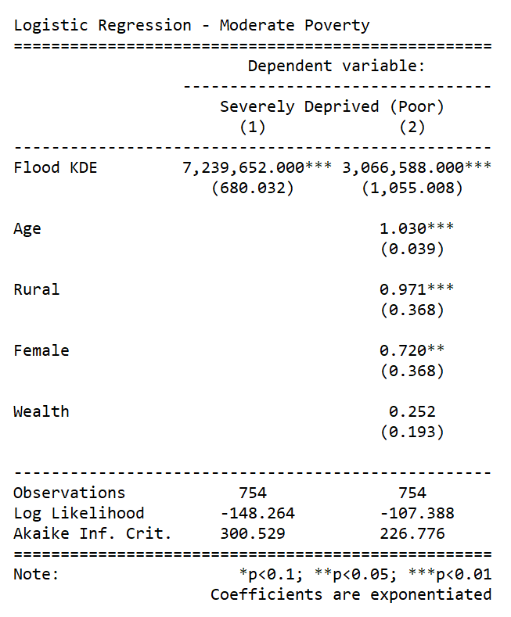

Regression Results

Slide 22
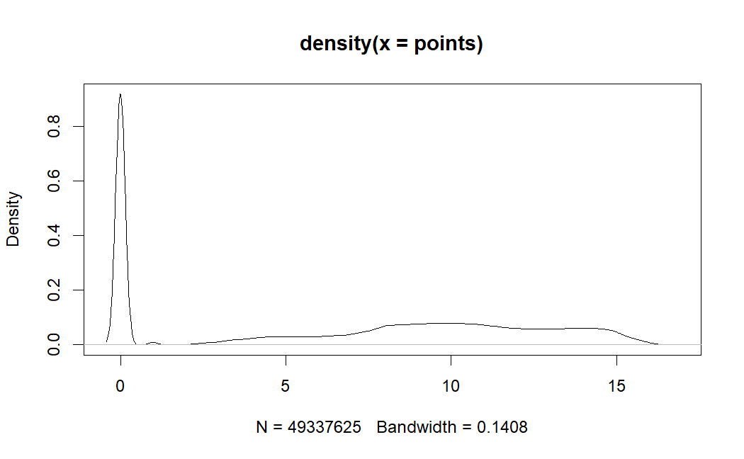
Kernel Density Estimates (Floods, Nigeria, 2018)

Slide 23
Relationship between MPI Dimensions & Floods: KDE Bandwidth (41x41)

Slide 24
Relationship between MPI Dimensions & Floods: KDE Bandwidth (1x1)

Slide 25
Relationship between MPI Dimensions & Floods: KDE Bandwidth (1x1)

Slide 26
Relationship between MPI Dimensions & Floods: KDE Bandwidth (1x1)

